Slide 1
AGRO Farming with Machine Learning
Abstract
Literature Survey
System Architecture
Algorithms
UML Diagrams
Output Screens
Test Cases
Conclusion

Slide 2
AGRO Farming with Machine Learning
Abstract:
A simple farmer will depend on the land and trusting in it he would lay the crop but there are times that led them to disaster.
As the educated beings we need to teach them to presume the perfect crop or be at their side in their difficult movements to suggest them.
We take the predefined datasets and evaluate the climatic changes, water management and the soil erosion
The evaluation would suggest the beneficiary crop for the year or for the period of the three to four months.

Slide 3
AGRO Farming with Machine Learning
Literature Survey
Paper | Author | Year | Result
AgroConsultant: Intelligent Crop Recommendation System Using Machine Learning Algorithm. | Subhash Nadkarni | 2018 | IOT and Machine Learning
Agricultural Production Output Prediction Using Supervised Machine Learning Techniques | Md. Tahmid Shakoor | 2017 | How to generate Analysis Using Machine Learning
Automated Farming Prediction | Talha Siddique | 2017 | Automation
A Hybrid Machine Learning Approach to Automatic Plant Phenotyping for Smart Agriculture | Talha Siddique | 2017 | Detecting Spoiled Crops

Slide 4

AGRO Farming with Machine Learning
System Architecture:
Taking input
1.Soil type
2.State and District
3.Water Level
4.Season
Displaying graph
Displaying Predicted Crop
Pesticides and Fertilizers
Data Set
Data Pre-Processing
Model
Predicting Crop
Predicting Production

Slide 5
AGRO Farming with Machine Learning
Data Preprocessing
Interface Building
Building Models
Accuracy Testing
Data Preprocessing is the first step
Building Models is the second step
Accuracy testing the main part to know accuracy of the model
Interface Building

Slide 6
AGRO Farming with Machine Learning
Algorithm
Predicting Production Rate
Missing Values
Predicting a Crop
Decision Tree
Decision Tree
Linear regression

Slide 7
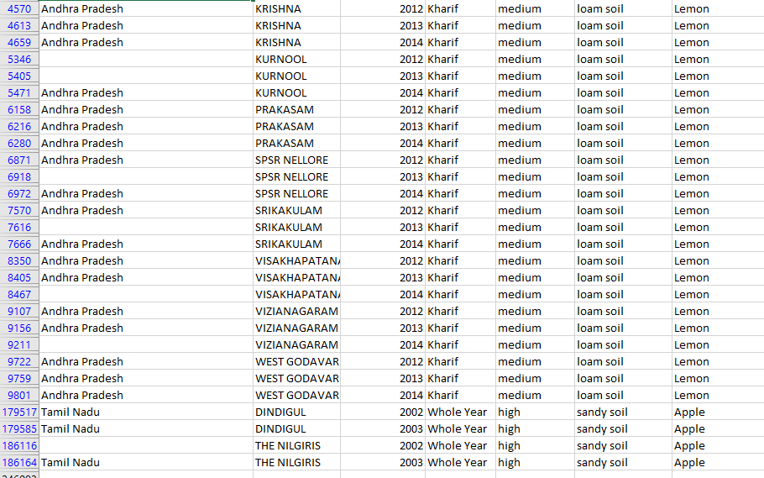
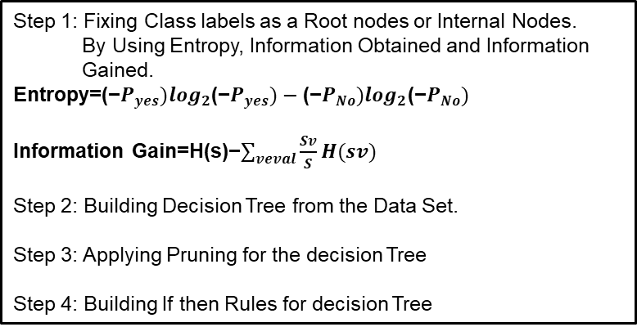
AGRO Farming with Machine Learning
Dependent
Independent variables
Algorithm
Decision Tree
Step 1: Fixing Class labels as a Root nodes or Internal Nodes.
By Using Entropy, Information Obtained and Information
Gained.
Entropy=(−$P_{yes})\log_{2}$(−$P_{yes})−\text{(−}P_{No})\log_{2}\text{(−}P_{No})$
Information Gain=H(s)−$\sum_{veval}{\frac{Sv}{S}}H(sv)$
Step 2: Building Decision Tree from the Data Set.
Step 3: Applying Pruning for the decision Tree
Step 4: Building If then Rules for decision Tree

Slide 8
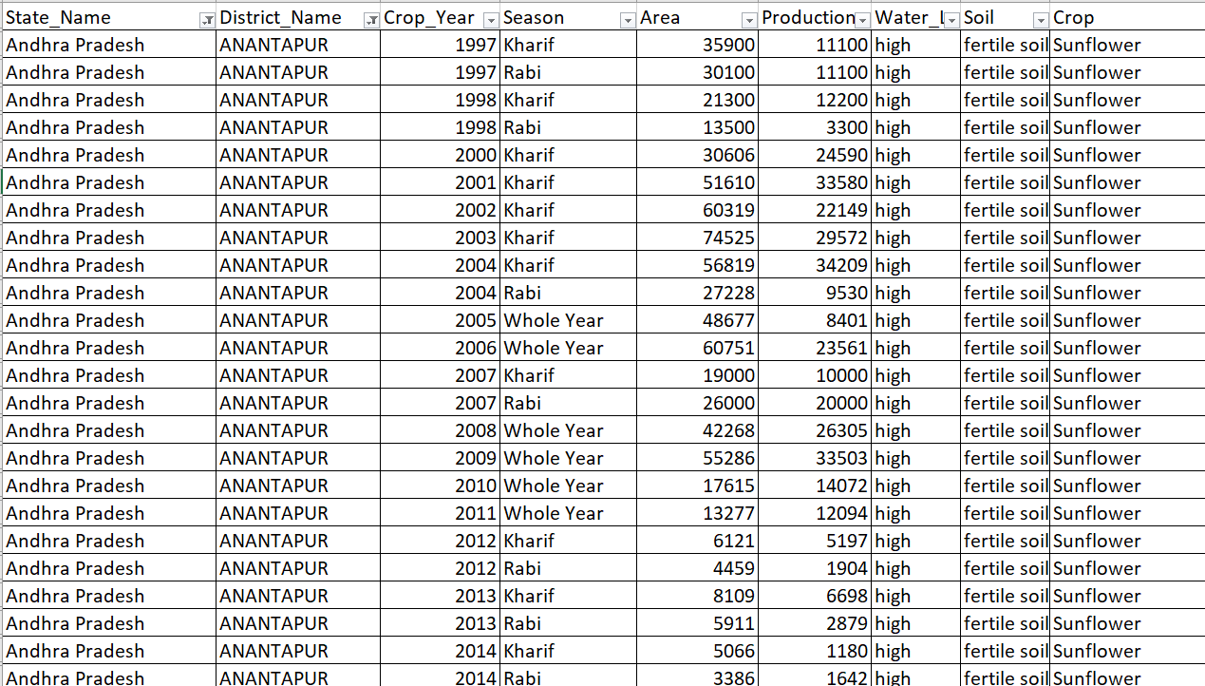
AGRO Farming with Machine Learning
Algorithm
Regression Tree
In statistics, linear regression is a linear approach to modeling the relationship between a scalar response and one or more explanatory variables. The case of one explanatory variable is called simple linear regression. For more than one explanatory variable, the process is called multiple linear regression
Simple Linear Regression
X → Y
Production → Year

Slide 9
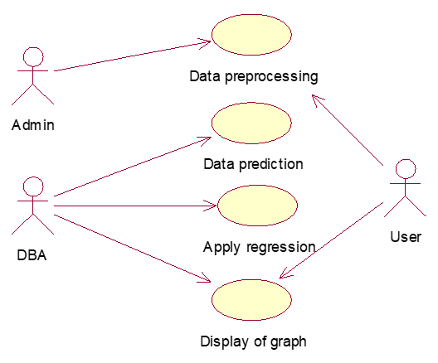
AGRO Farming with Machine Learning
UML Diagrams
USE CASE DIAGRAM:
Use case diagrams are a way to capture the system's functionality and requirements in UML diagrams. It captures the dynamic behavior of a live system. A use case diagram consists of a use case and an actor. ... A purpose of use case diagram is to capture the core functionalities of a system

Slide 10
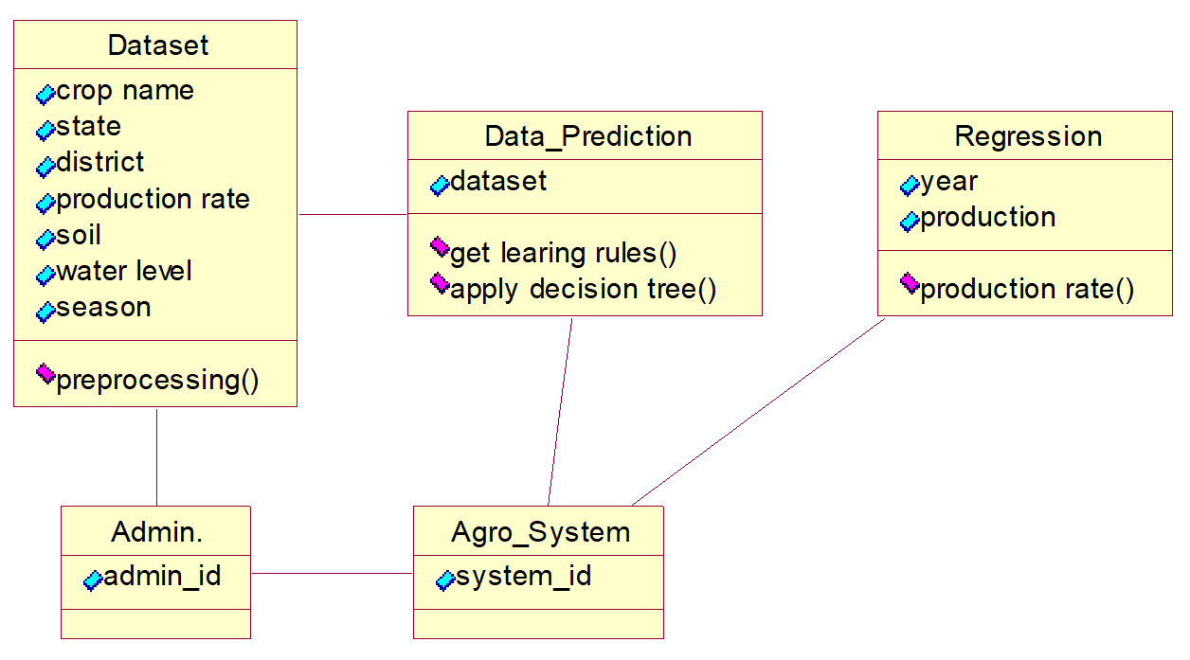
AGRO Farming with Machine Learning
UML Diagrams
Class Diagram:
Class diagrams are the only diagrams which can be directly mapped with object-oriented languages and thus widely used at the time of construction. ... It is the most popular UML diagram in the coder community.

Slide 11
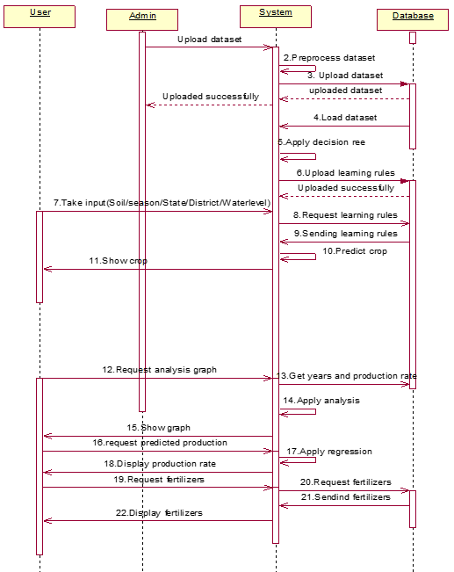
AGRO Farming with Machine Learning
UML Diagrams
Sequence Diagram:
The sequence diagram is a good diagram to use to document a system's requirements and to flush out a system's design. The reason the sequence diagram is so useful is because it shows the interaction logic between the objects in the system in the time order that the interactions take place.

Slide 12
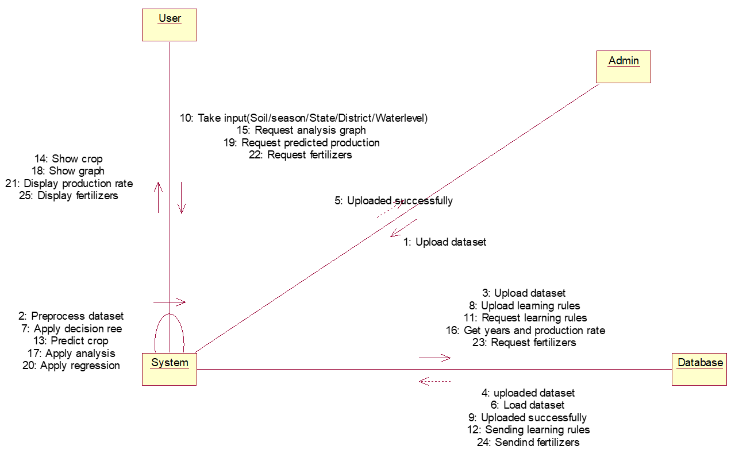
AGRO Farming with Machine Learning
UML Diagrams
Collaboration Diagram:
Collaboration are used by designers to define and clarify the roles of the objects that perform a particular flow of events of a use case. They are the primary source of information used to determining class responsibilities and interfaces.

Slide 13
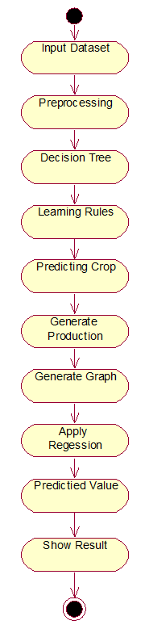
AGRO Farming with Machine Learning
UML Diagrams
Activity Diagram:
An activity diagram is used by developers to understand the flow of programs on a high level. It also enables them to figure out constraints and conditions that cause particular events.

Slide 14
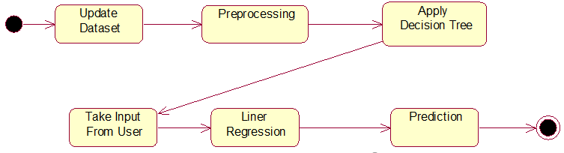
AGRO Farming with Machine Learning
UML Diagrams
State chart Diagram:
State chart diagrams are designed to capture the dynamic behavior of an application system. These diagrams are used to represent various states of a system and entities within the system.

Slide 15
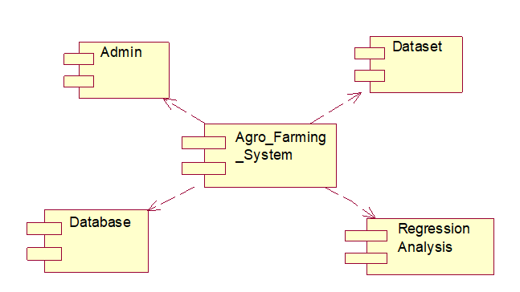
AGRO Farming with Machine Learning
UML Diagrams
Component Diagram:
Component diagrams are used to model the physical aspects of a system. ... Component diagrams are used to visualize the organization and relationships among components in a system. These diagrams are also used to make executable systems.

Slide 16
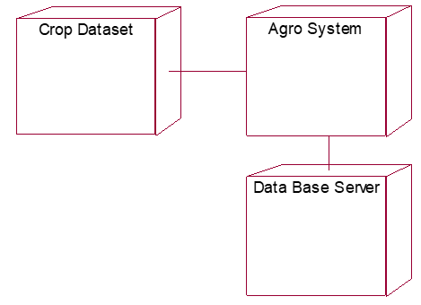
AGRO Farming with Machine Learning
UML Diagrams
Deployment Diagram:
Deployment diagrams are mainly used by system engineers. These diagrams are used to describe the physical components (hardware), their distribution, and association. Deployment diagrams can be visualized as the hardware components/nodes on which the software components reside.

Slide 17
Agro Farming Using Machine Learning
Output Screens
INPUT SCREEN
PREDICTING VALUE FOR NEXT YEAR
PREDICTED CROPS
RELATED FERTILIZERS
GENERATING GRAPHS
RELATED PESTICIDES

Slide 18
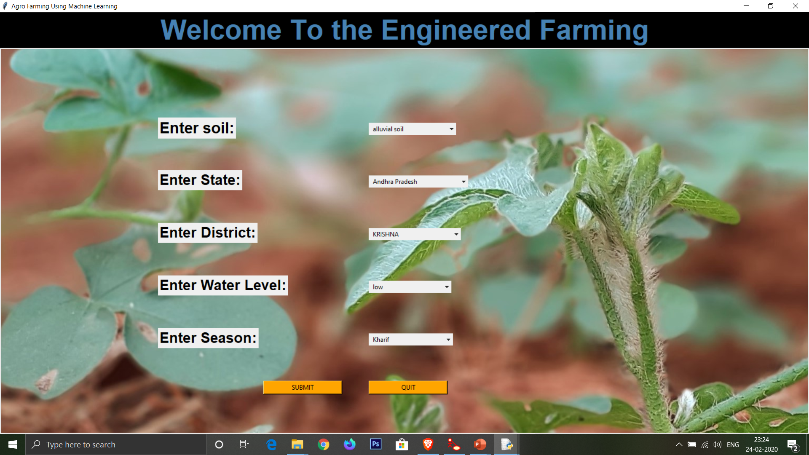
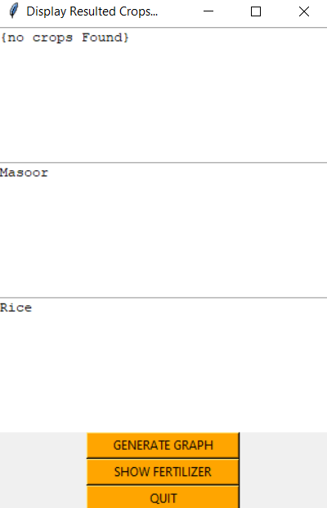
AGRO Farming with Machine Learning
Home Screen
Crop Prediction(Decision Tree)

Slide 19
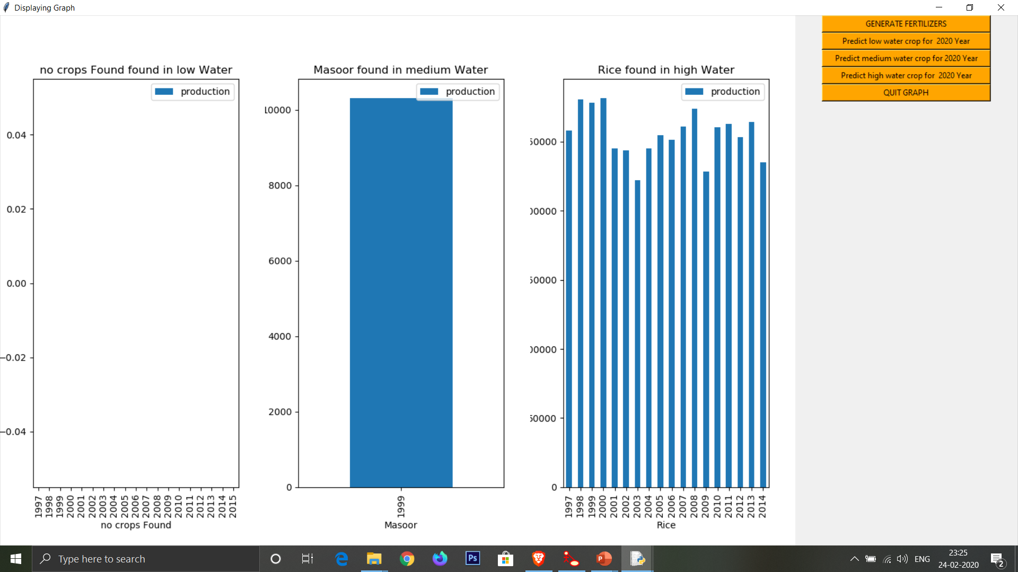
AGRO Farming with Machine Learning
Analysis Representation

Slide 20
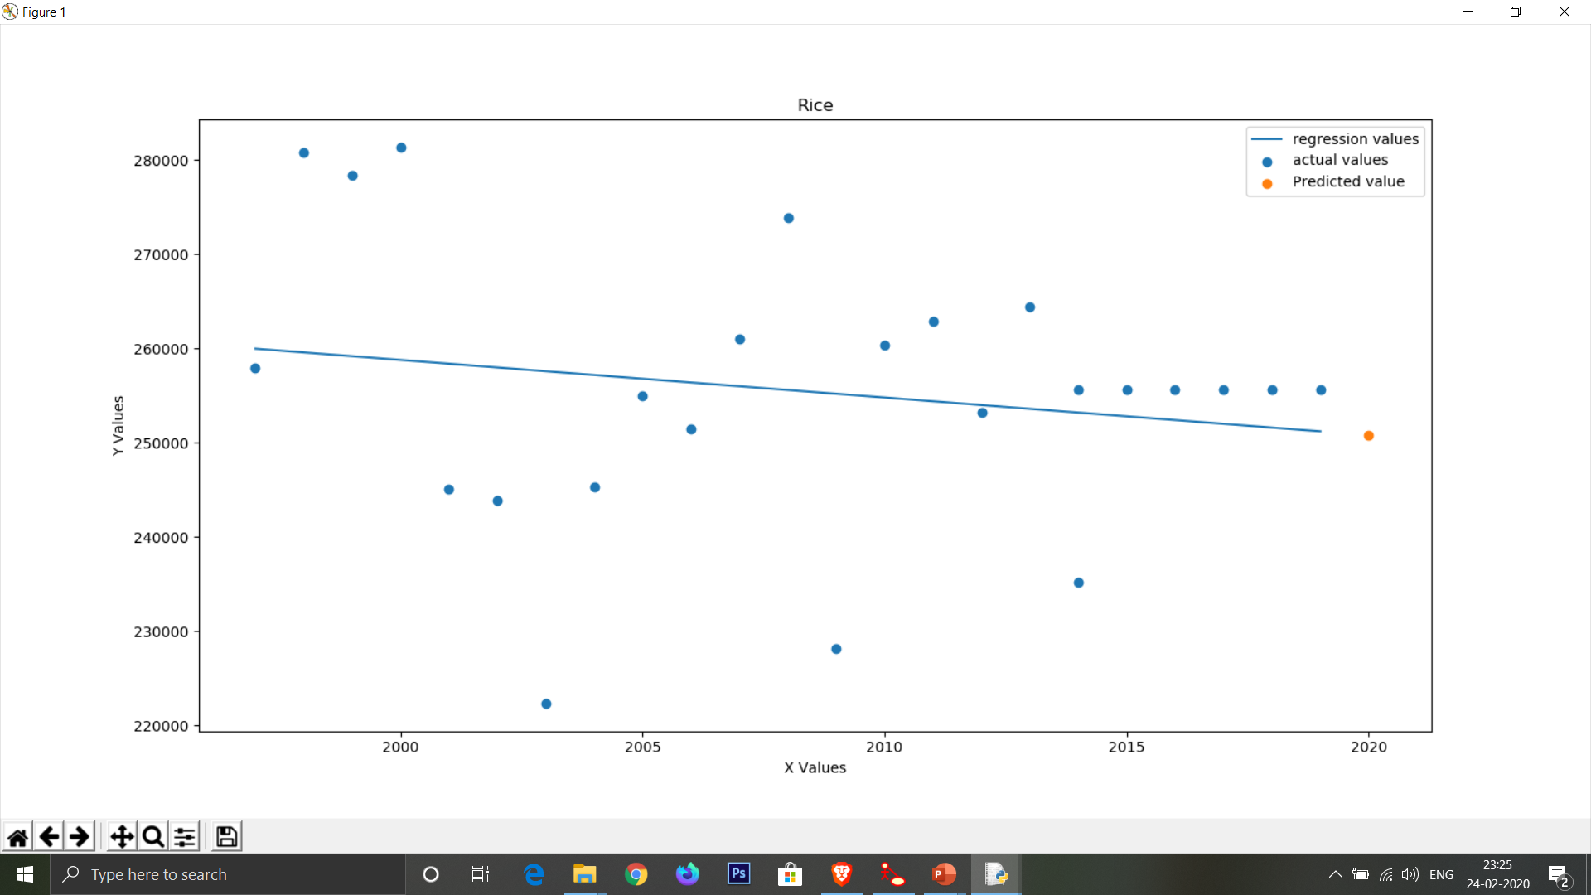
AGRO Farming with Machine Learning
Linear Regression Graph

Slide 21
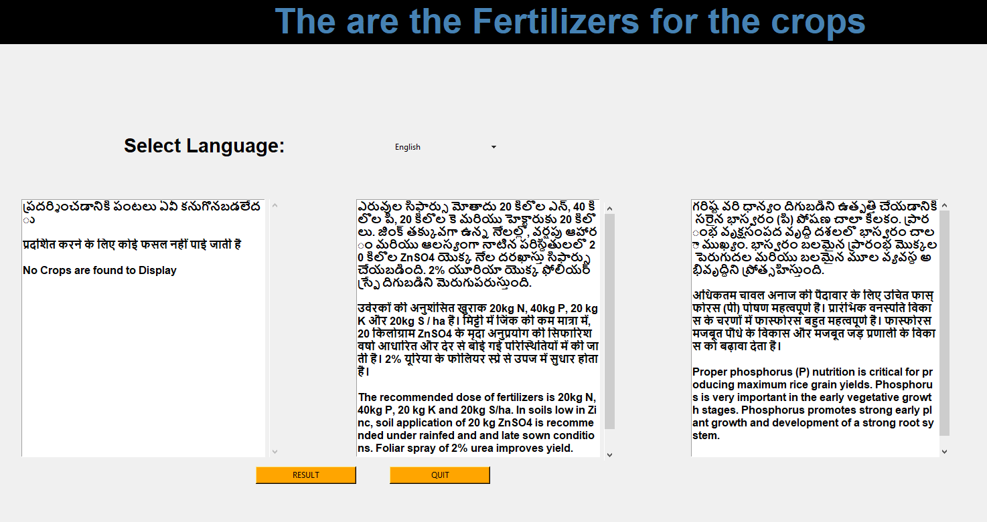
AGRO Farming with Machine Learning
Suggesting Pesticides

Slide 22
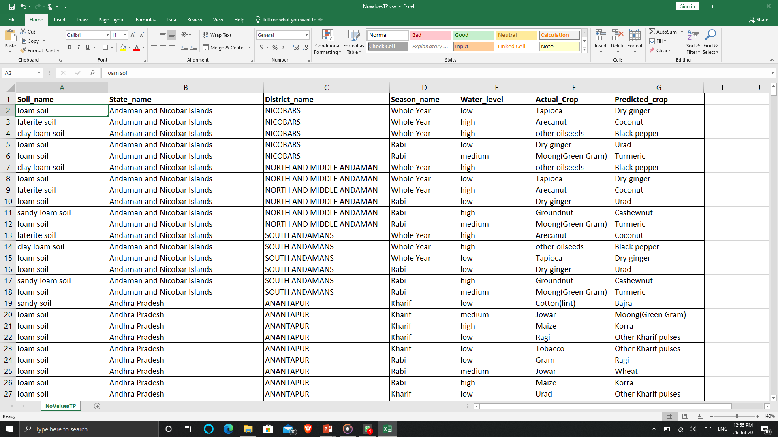
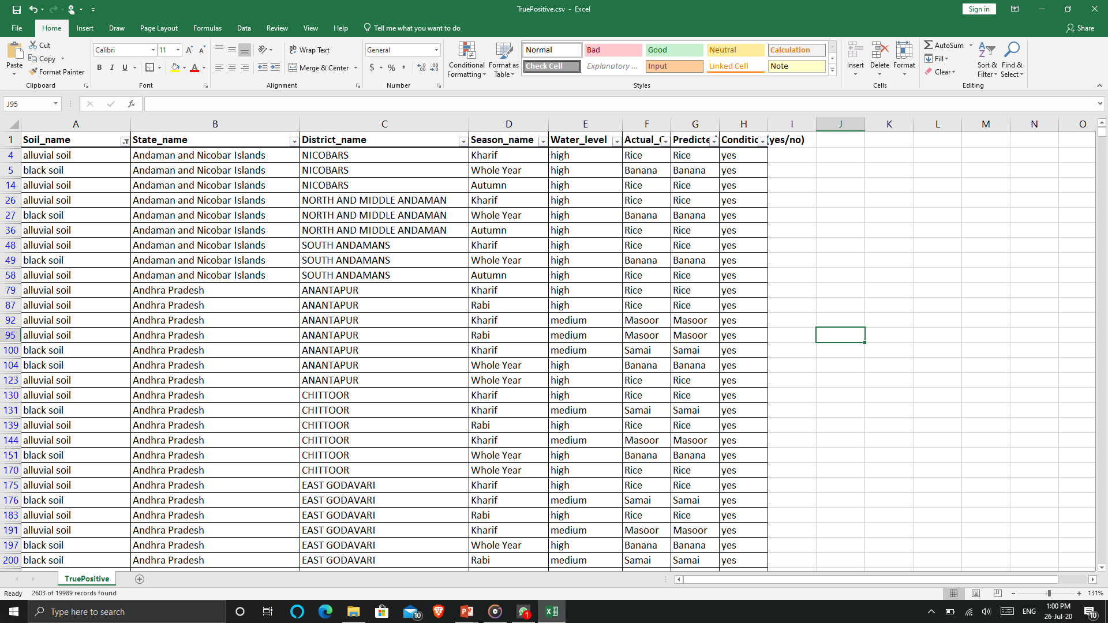
AGRO Farming with Machine Learning
Accuracy Testing
Suggesting Best suitable Crop
True Positive

Slide 23
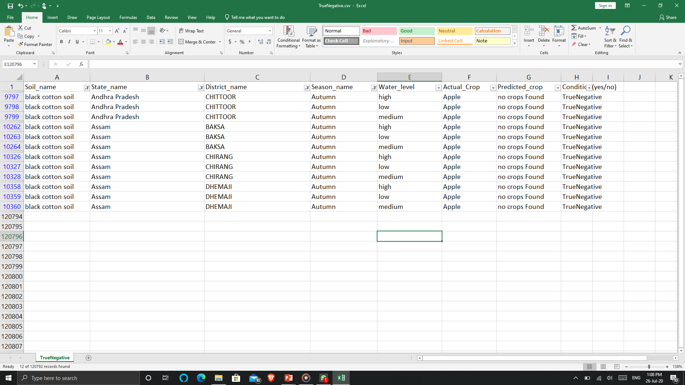
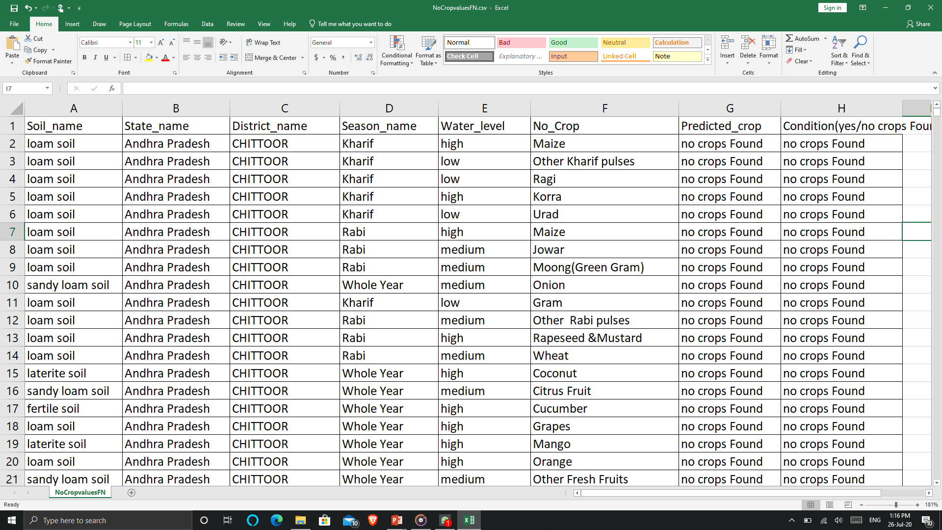
AGRO Farming with Machine Learning
Accuracy Testing
True Negative
False Positive

Slide 24
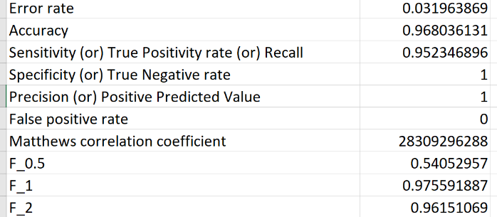
AGRO Farming with Machine Learning
Conclusion:
We completed the crop and production prediction by using Machine Learning
On testing accuracy we got the accuracy score of 98 percent and error rate of 2 percent
By this we can conclude that this project will help the farmers for predicting the crops

Slide 25
THANK YOU

